Slide 1
THE GREAT INDIA HACKATHON

Slide 2
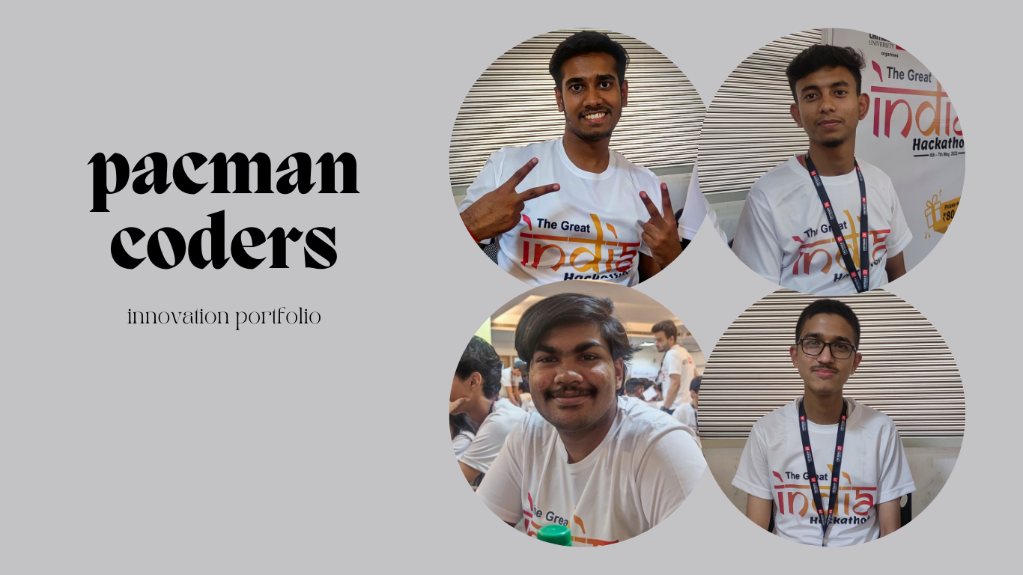

Slide 3
Problem
There are many daily life problem, struggle and challenging that are faced by blind people. Some of the problems are :
Navigation around places.
Limited access to outside world.
Finding reading material.

Slide 4
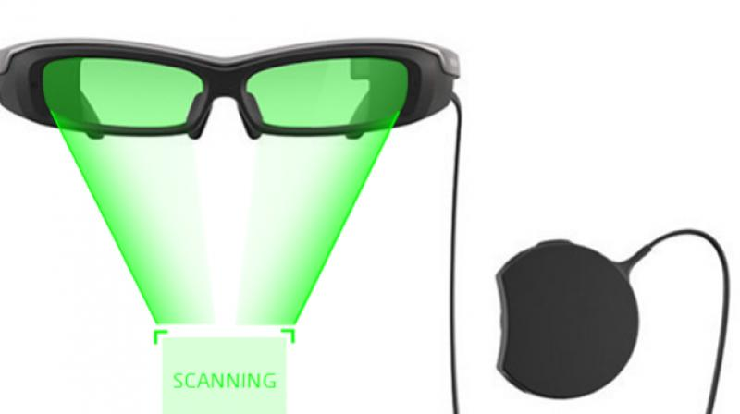
Proposed Solution
AI Powered Smart Glasses
Our Prototype can be used in everything including screen reading, object detection and navigation.

Slide 5
Tech Stack
So technology we are using is
Artificial Intelligence
Machine Learning
Python
Augmented Reality(AR)

Slide 6

Scalability And Uniqueness
There are an estimated 253 million people with visual impairment worldwide. Of these 36 million were blind and a further 217 million had moderate to severe visual impairment.

Slide 7

THANK YOU

